Slide 1
Stock Market Analysis
By
Georgekutty James - GXJ200004
Saheli Roy Choudhury – SXR200029
Roshan Tiwari – RKT200000
Bhargava Venkat – BXL210005
Sandesh Reddy – SRB210004

Slide 2
Objective
Top 10 Companies with highest rate of change in its stock price within company’s lifetime.
By monitoring alignment between major geo-political events like covid outbreak and Ukraine-Russia war and stock prices we will establish intensity of various events.
By merging our primary dataset with twitter data, we will define a correlation between trending companies and their share prices

Slide 3




System Architecture

Slide 4
Dataset
Stock Price Data: Everyday stock prices for different companied traded in NASDAQ stock exchange
https://www.kaggle.com/datasets/paultimothymooney/stock-market-data
Twitter Data: This dataset contains over 3 million unique tweets with their information such as tweet id, author of the tweet, post date, the text body of the tweet, and the number of comments, likes, and retweets of tweets matched with the related company.
https://www.kaggle.com/code/tommyupton/twitter-stock-market-sentiment-analysis/data

Slide 5
Data Components
Date - Date that tweet was made
Writer - The twitter user that made the tweet
Body – The actual content of the tweet
Comments - Number of comments on tweet
Retweets - Number of times it was retweeted
Likes - Number of likes on the tweet
Total Engagement – Calculated column calculated by summing likes, comments and retweets.

Slide 6
Data Components
Date: The date is in the format yy-mm-dd
Open: Price of the stock when the market opens
High: Highest price reached in the day
Low: Lowest price reached in the day
Close: Price of the stock when the market closes
Volume: Number of shares traded in a day
Dividends: The dividends of the stock
Stock Splits: The stock splits of the company. In a stock split, a company divides its existing stock into multiple shares to boost liquidity.

Slide 7
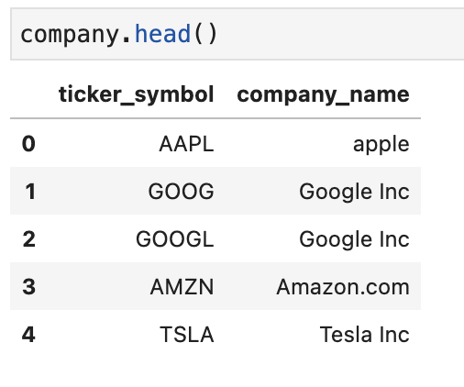
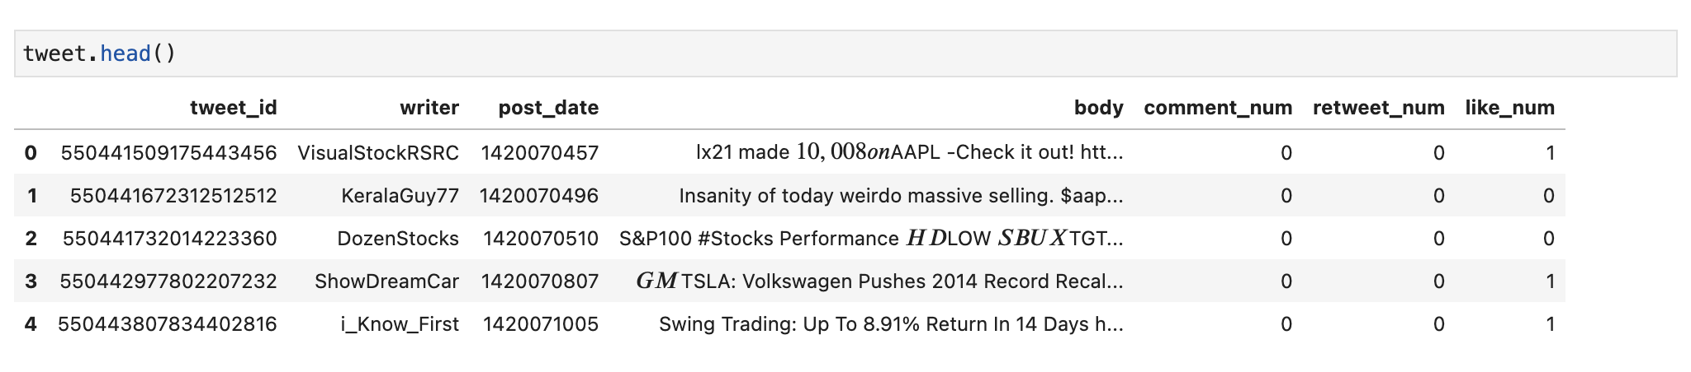
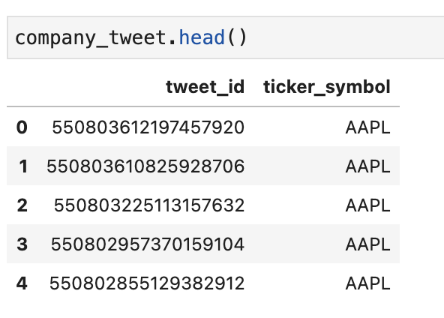
Effect of public opinion about a company on that company's market values
We have 3 datasets - company identifier, tweet identifier and company tweet

Slide 8
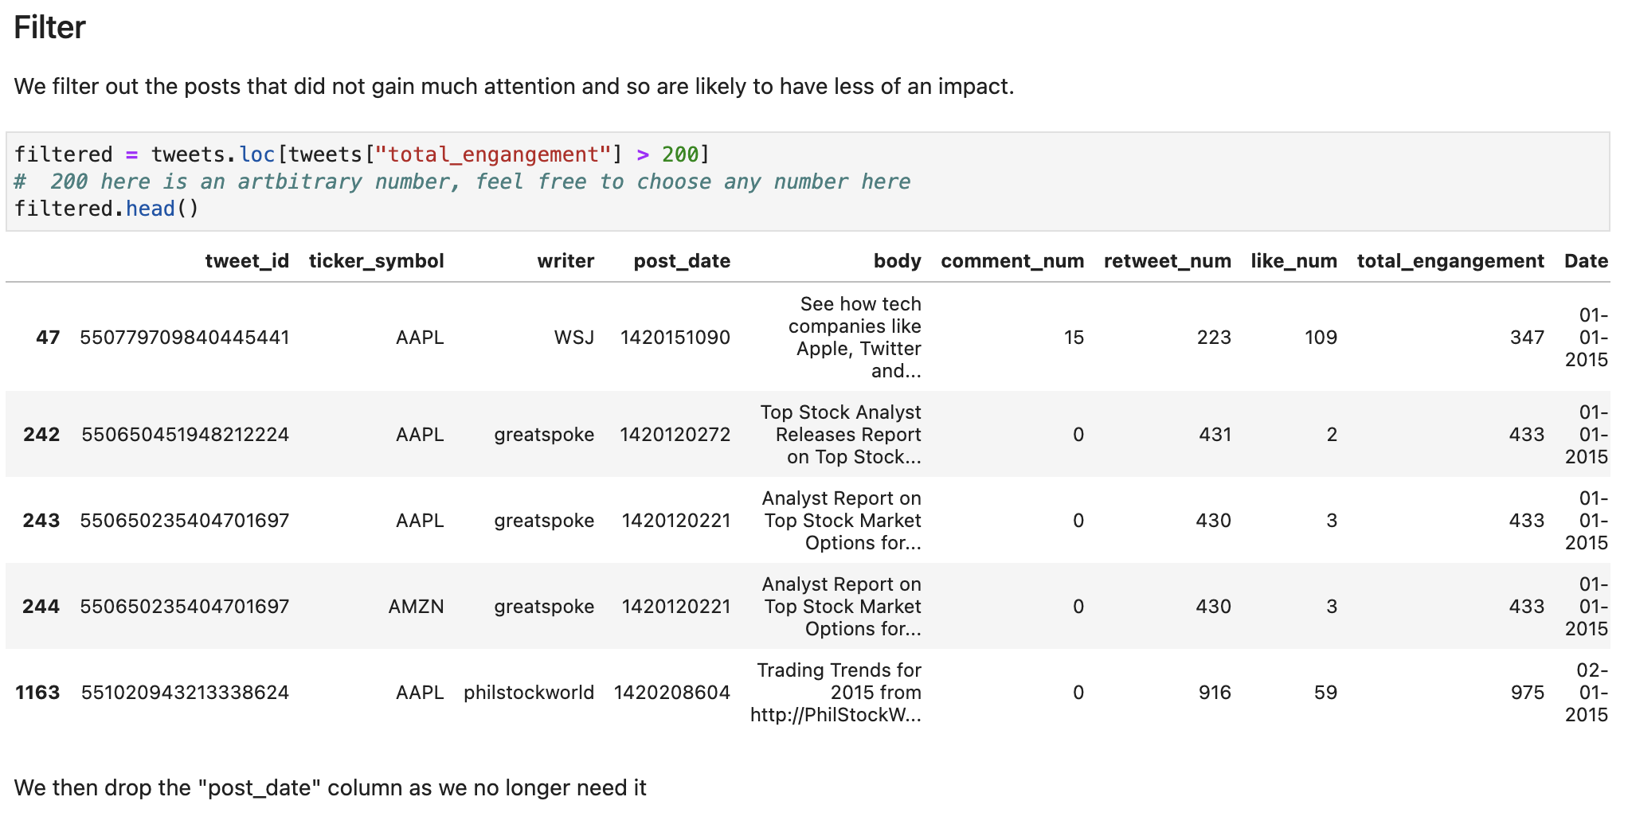
Effect of public opinion about a company on that company's market values
We merged the three datasets and filtered out all tweets which have less than 200 engagement (people followed the tweet, liked or retweeted)

Slide 9
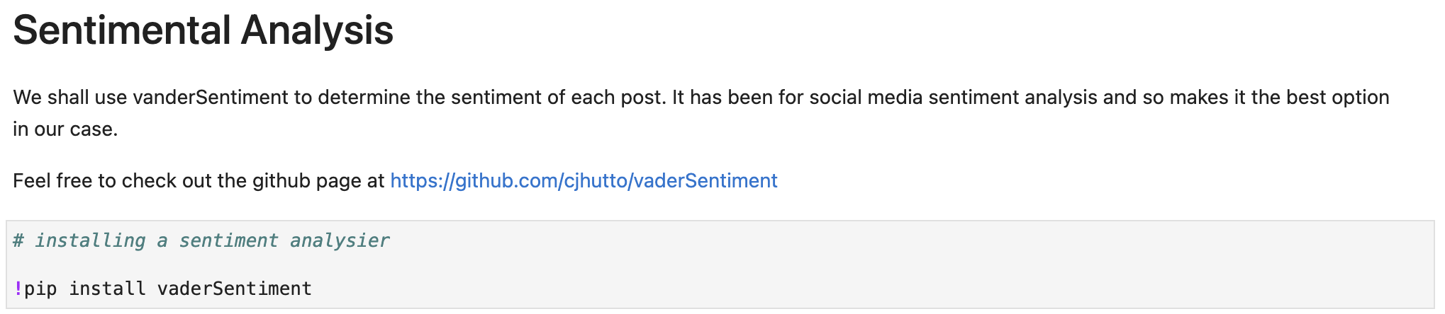
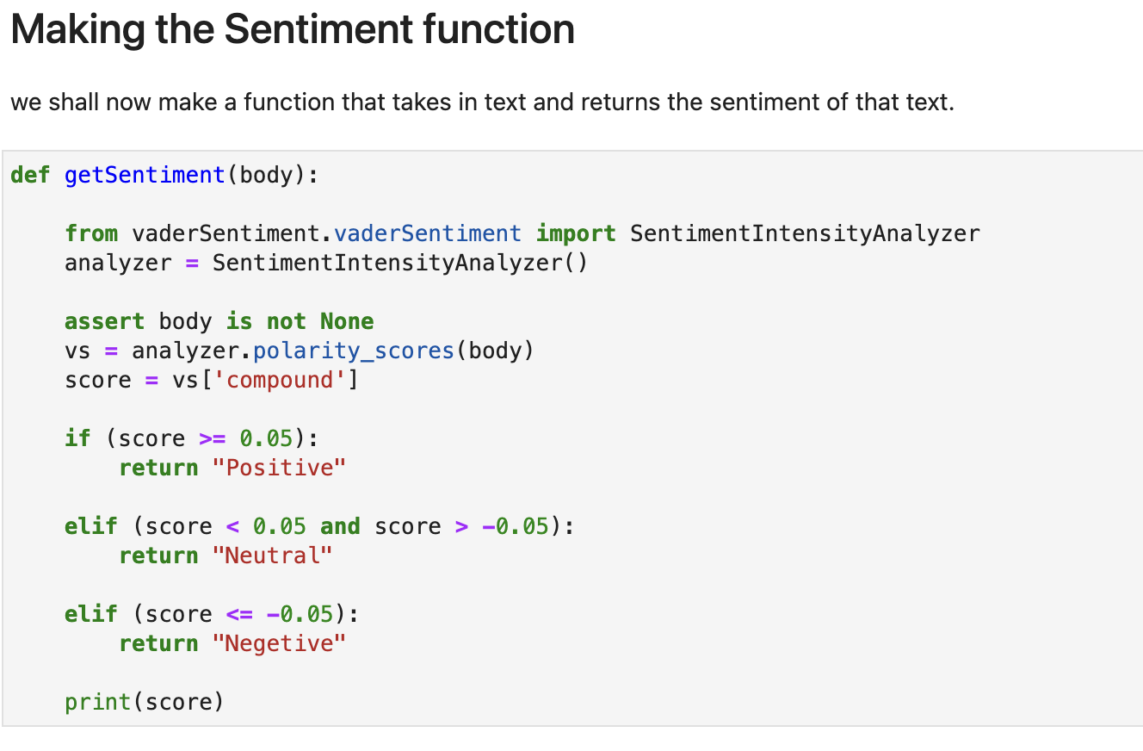
Effect of public opinion about a company on that company's market values
We then ran sentimental analysis on the tweet body to categorize tweets into:
positive, negative and neutral

Slide 10
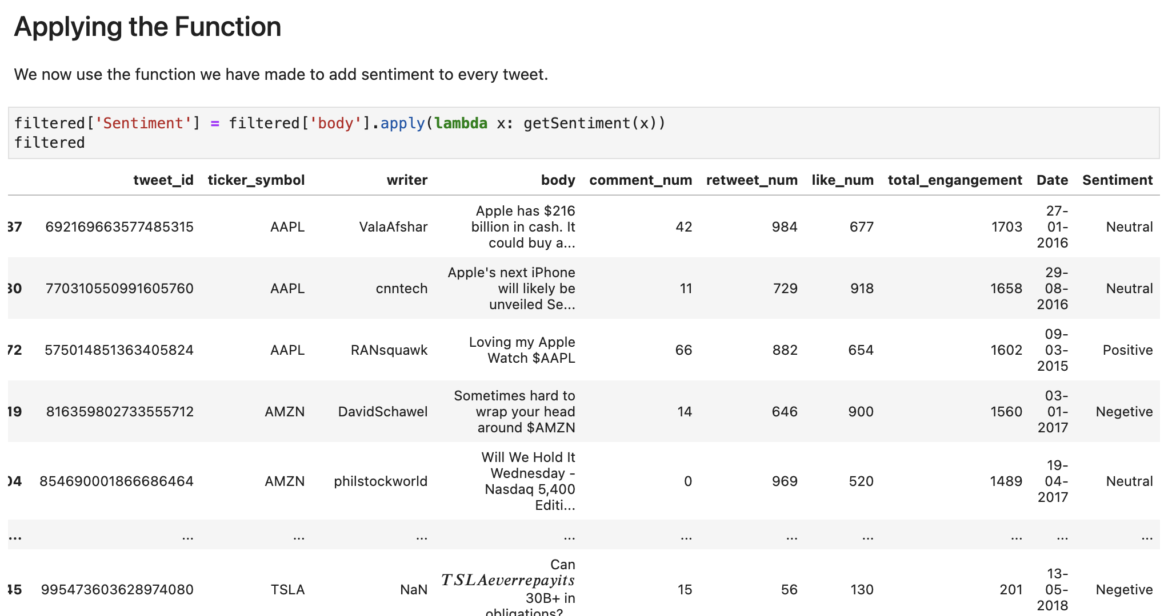
Effect of public opinion about a company on that company's market values
We then ran sentimental analysis on the tweet body to categorize tweets into:
positive, negative and neutral

Slide 11
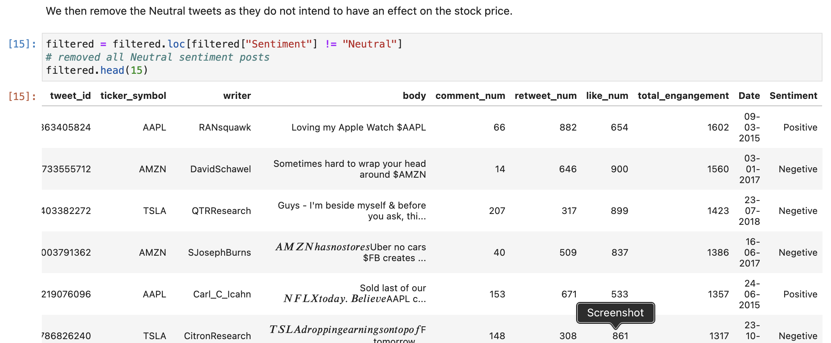
Effect of public opinion about a company on that company's market values
We again filtered data removing neutral tweets, and other unnecessary columns

Slide 12
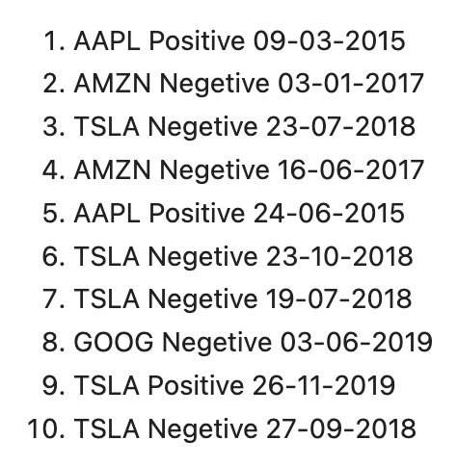
Effect of public opinion about a company on that company's market values
We then sort the final data frame and checked the top 10 tweets and its effect on stock price.
In these top 10 tweets, we have companies like Apple, Tesla, Amazon and Google.
We have plotted the stock price of the company around the day of the tweet and checked whether the sentiment of the tweet has caused any effects on the stock price.

Slide 13
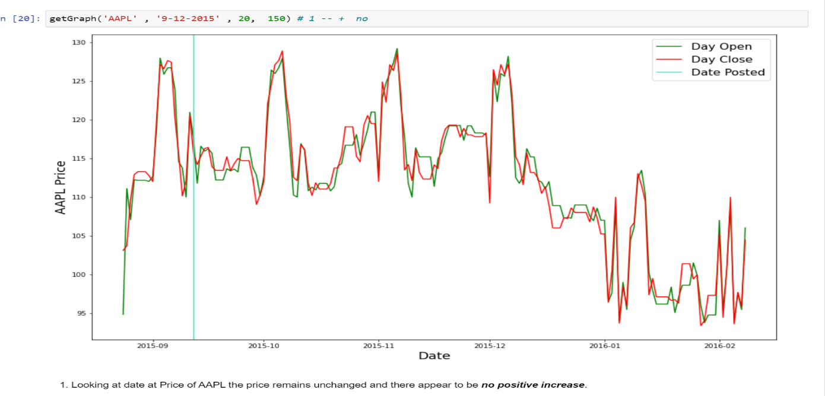
FINDINGS
Looking at date at price of AAPL the price remains unchanged and there appear to be no positive increase

Slide 14
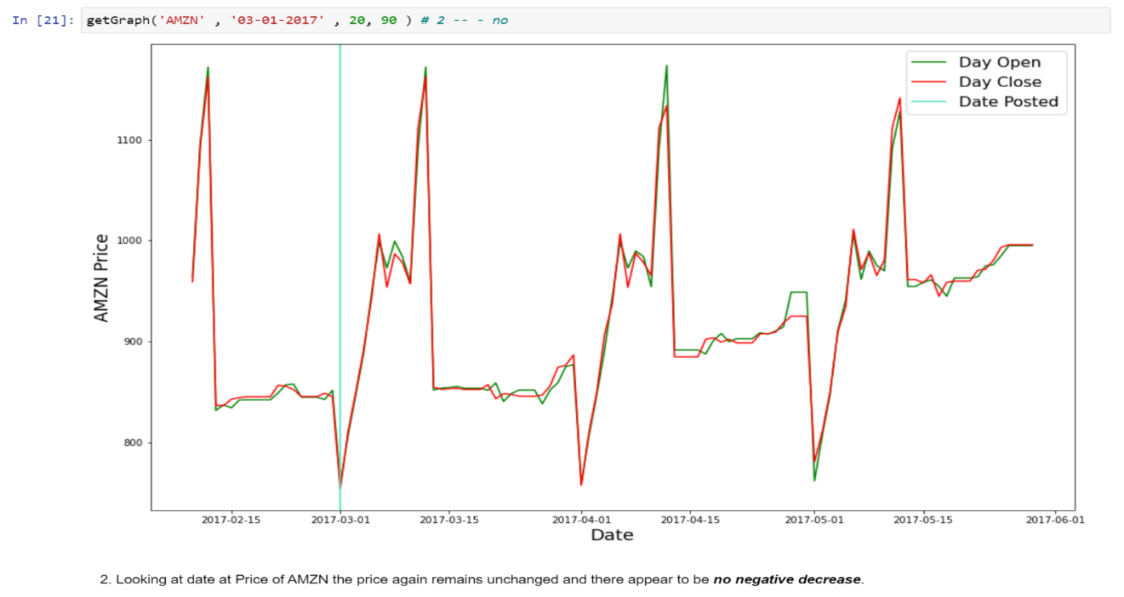
Looking at date at price of AMZN the price again remains unchanged and there appear to be no Negative decrease.

Slide 15
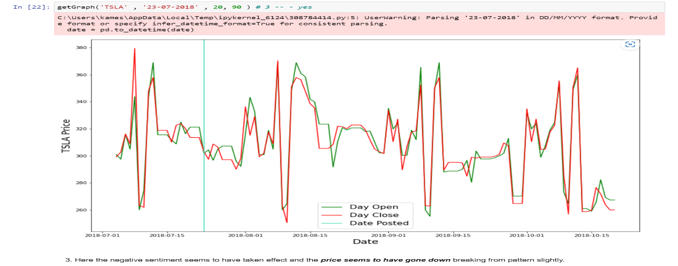
Here the negative sentiment seems to have taken effect and the price seems to have gone down from pattern slightly.

Slide 16
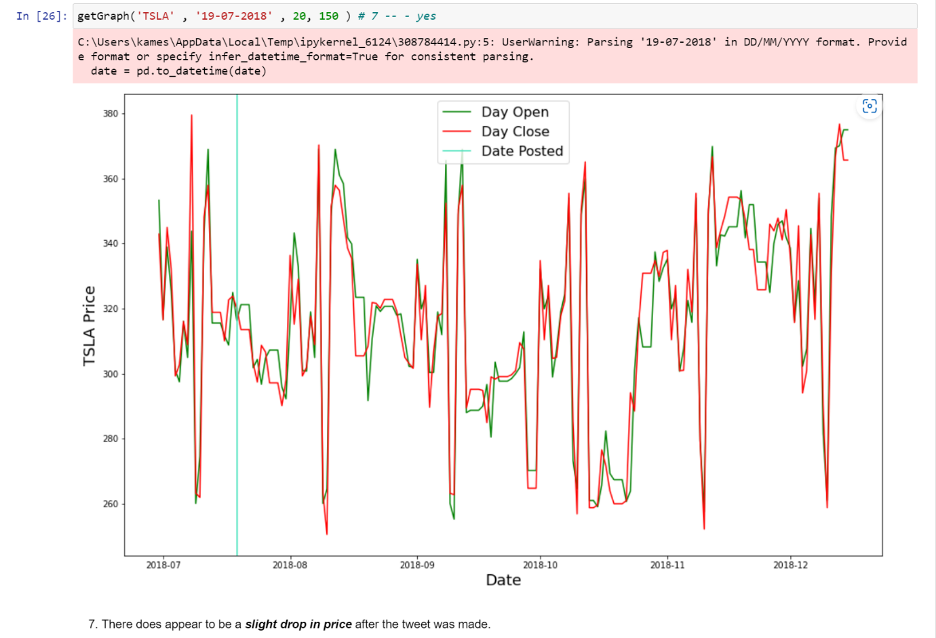
Here in the graph there is a slight drop in price after the tweet was made.

Slide 17
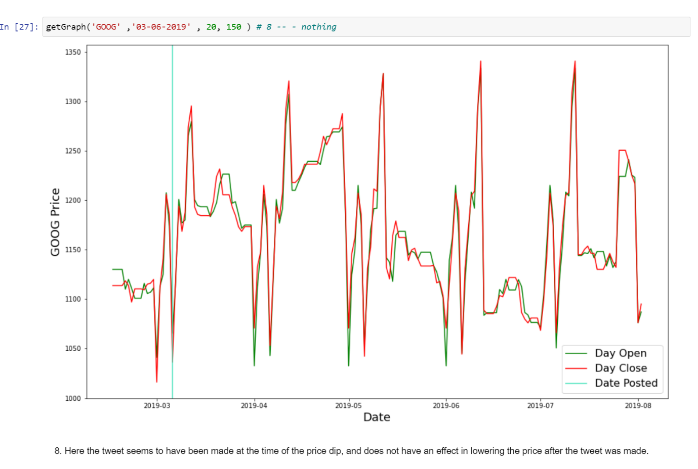
Here in the graph the tweet seems to have been made at the time of price dip, and does not have an effect in lowering the price after tweet was made.

Slide 18
Pre-Implementation Analysis Conclusion
Yes, twitter does have an effect on the stock market but it is not nessecary that if your tweet does go viral it will raise or lower stock prices.
Out of 10 of the most popular tweets only 4 (40%) had an effect on the stock market.

Slide 19
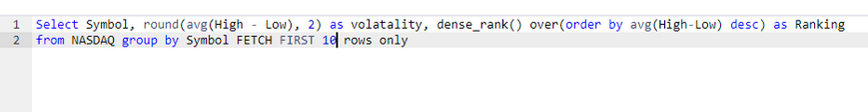
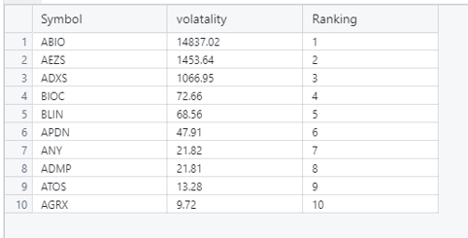
Calculating Volatility

Slide 20
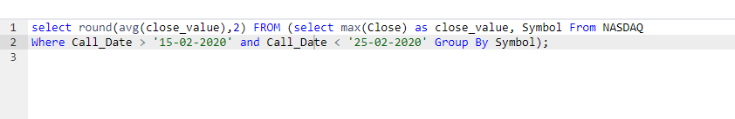
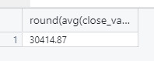
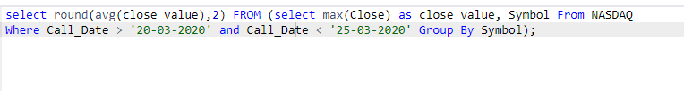
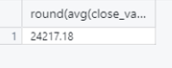
Calculating Market Drop

Slide 21
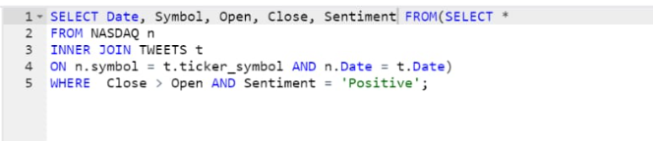
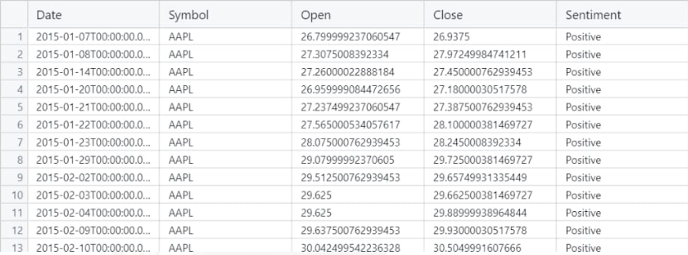
Joining Tweets sentiment table and NASDAQ table

Slide 22
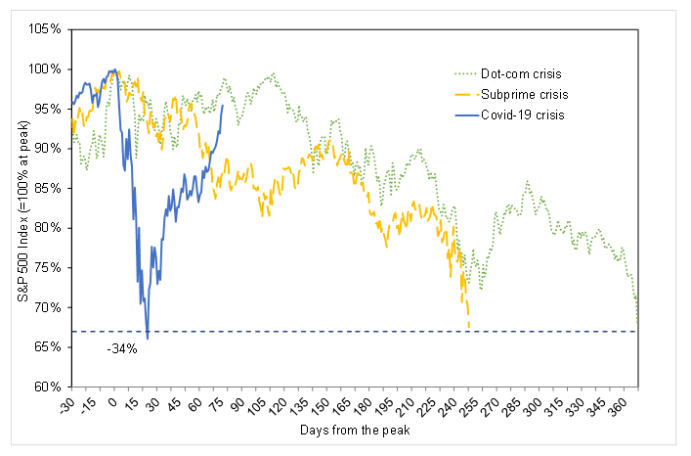
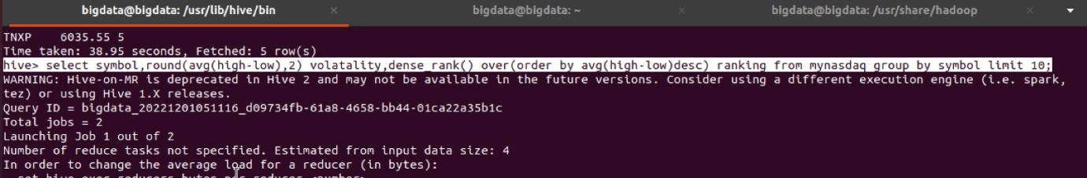
Case -1
Top 10 companies with highest rate of change in its stock price within companies lifetime.

Slide 23
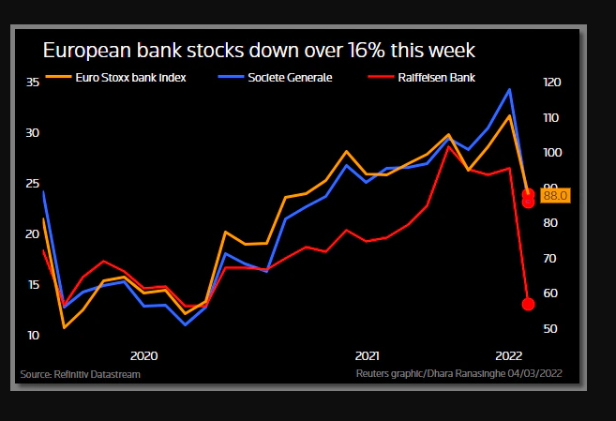
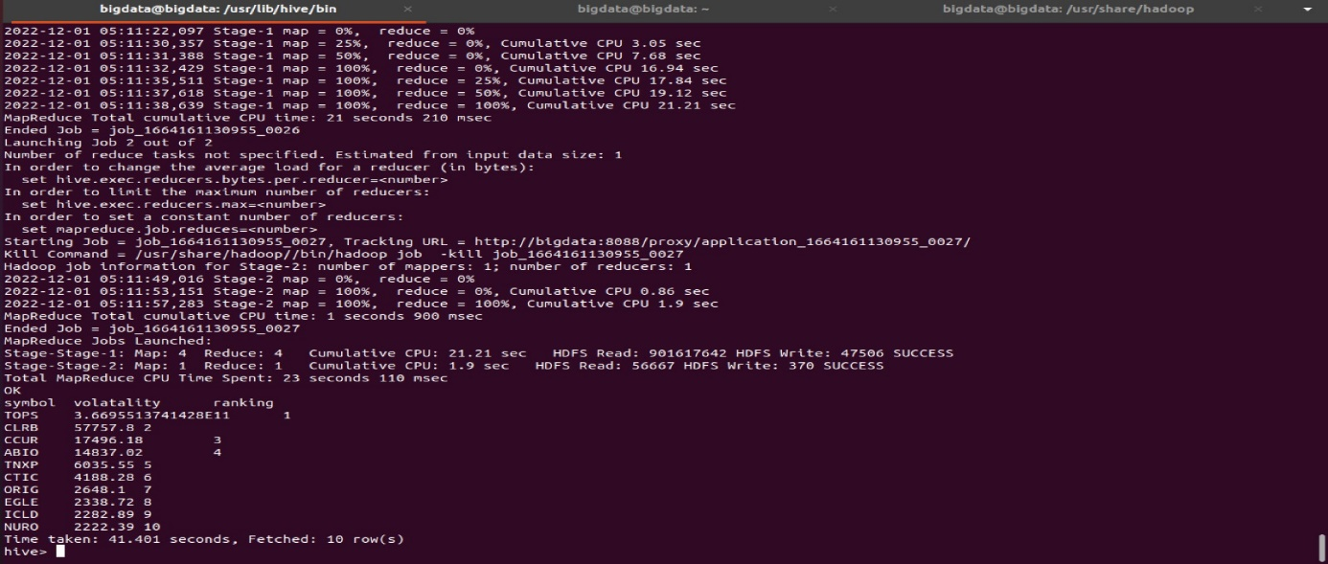

Slide 24
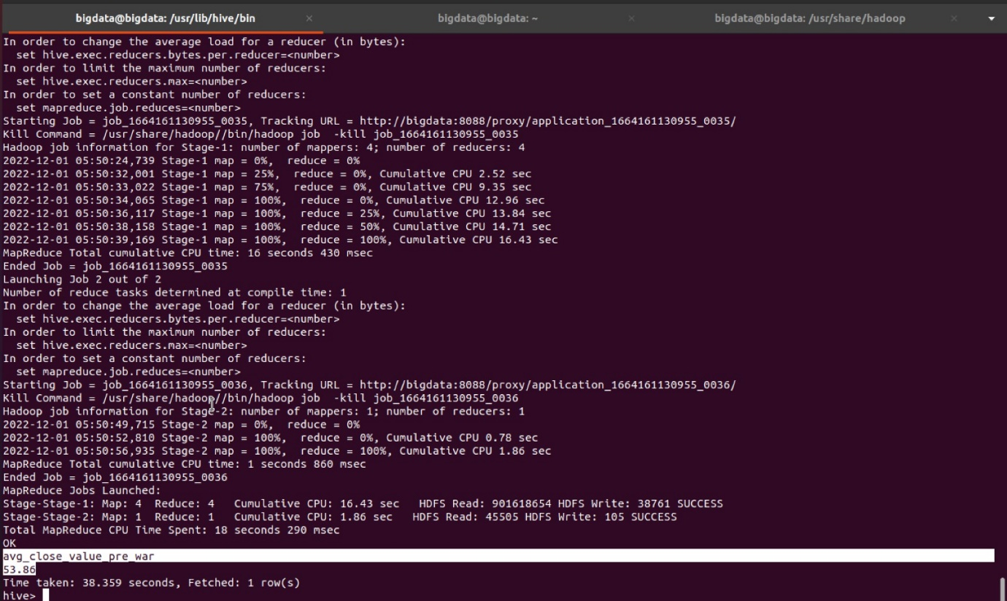
Case-2
By monitoring alignment between major geo-political events like covid outbreak and Ukraine-Russia war and stock prices we will establish intensity of various events.
Effect of war and covid on stock market

Slide 25
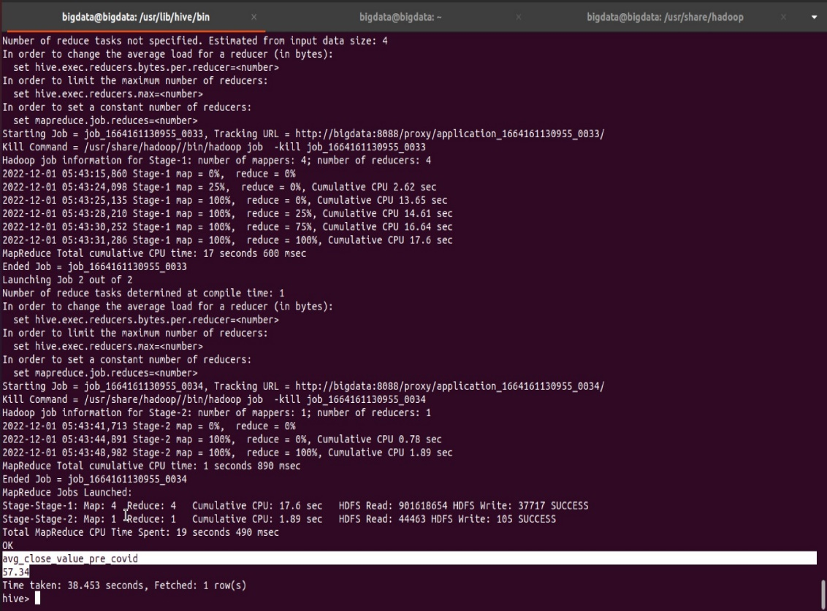
Avg Maximum closing price before war and covid

Slide 26
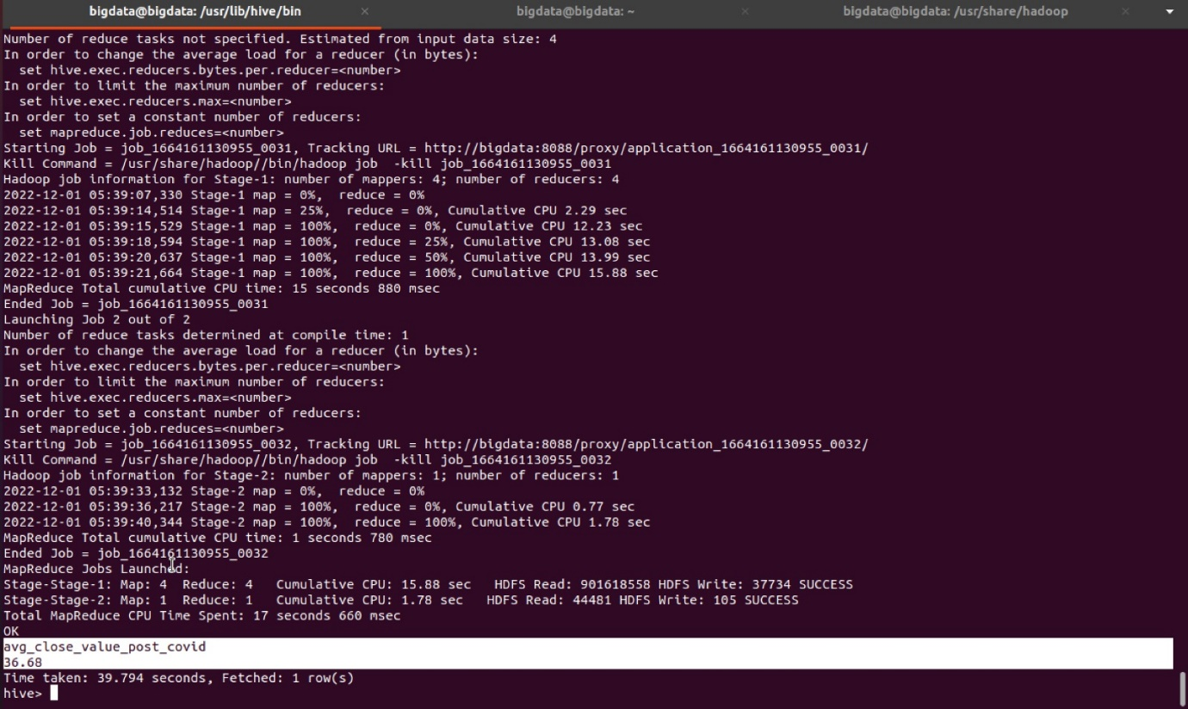
Avg Maximum closing price after war and covid

Slide 27
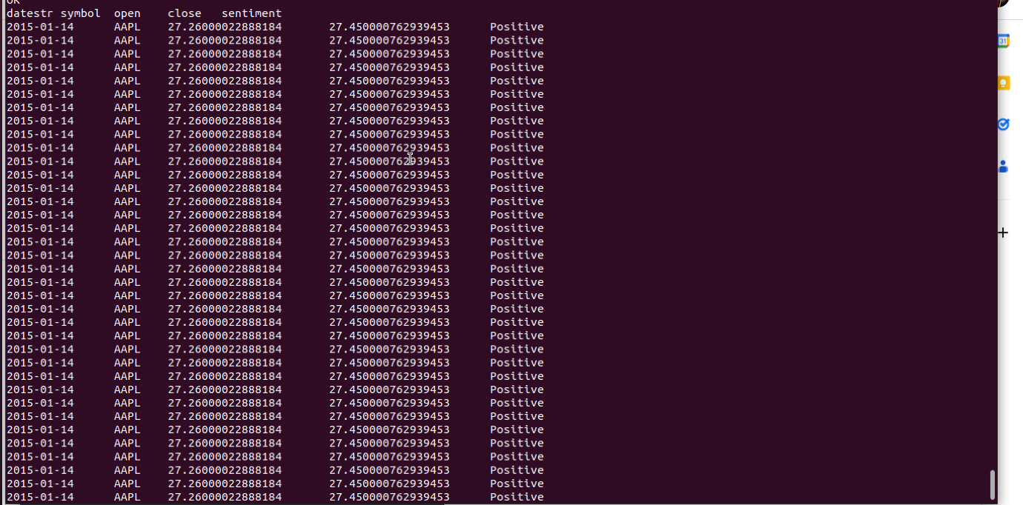
Case-3
Is opening and closing price have relation between positive tweets?

Slide 28
Conclusion
Volatility: The 3 most volatile companies surpass the next company on the list by a huge margin and they all belong to pharmaceutical and therapeutics industry:
ABIO -arca Biopharma
AEZS -Aeterna Zentaria
ADXS -Advaxis Inc.
The market dropped by 37% after covid while war only dropped the market by 10%
There is not a clear way of telling if a viral tweet will affect the stock prices or not. 40-50% of tweets have a corresponding effect. That is positive tweet correspond to an increase in price and negative viral tweets have a negative impact on stock price. Further analysis can be done to find commonalities between the tweets that have a corresponding effect.

